Slide 1


为什么要并行计算？
任课教师：王桢

Slide 2
课程内容
参考资料：
并行程序设计导论，Peter S Pacheco, 机械工业出版社， 2016
CHAPTER 1 Why Parallel Computing?

Slide 3
Roadmap
Why we need ever-increasing performance.
Why we’re building parallel systems.
Why we need to write parallel programs.
How do we write parallel programs?
What we’ll be doing.
Concurrent, parallel, distributed!

Slide 4
Why we need ever-increasing performance
Computational power is increasing, but so are our computation problems and needs.
Problems we never dreamed of have been solved because of past increases, such as decoding the human genome.
More complex problems are still waiting to be solved.

Slide 5

Climate modeling

Slide 6
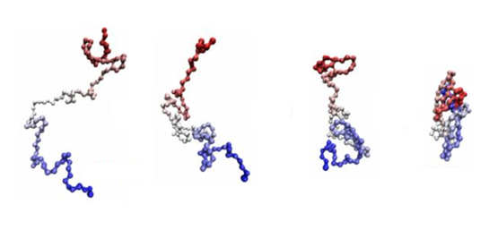
Protein folding

Slide 7


Drug discovery

Slide 8


Energy research

Slide 9


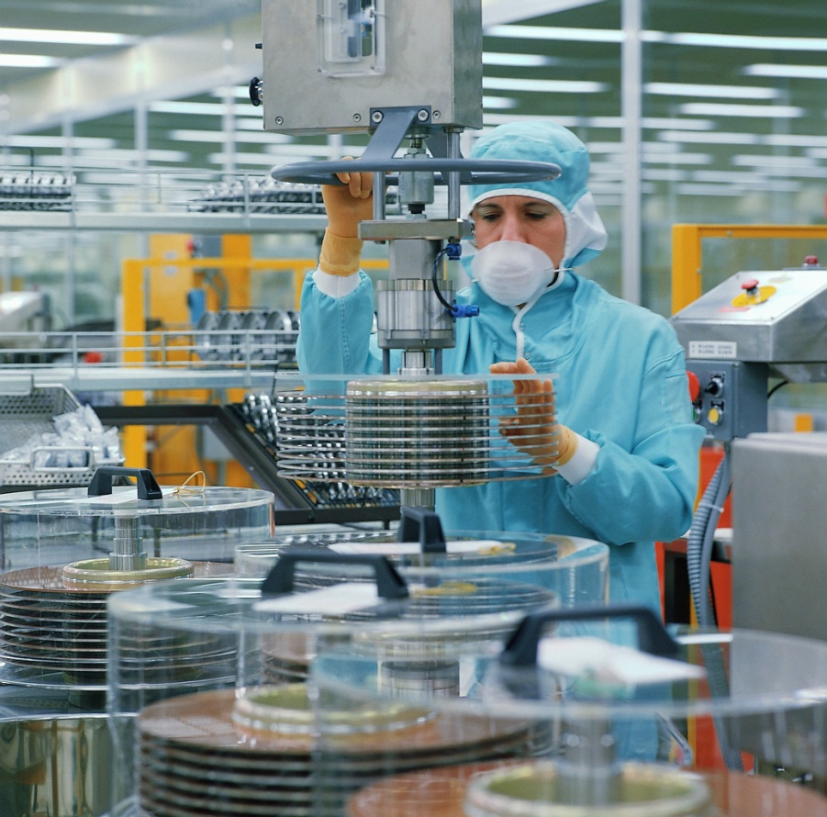
Data analysis
Big data enable big model to work well

Slide 10
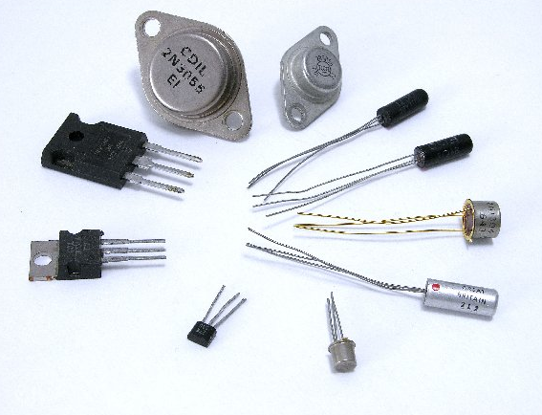
Why we’re building parallel systems
Up to now, performance increases have been attributable to increasing density of transistors.
But there are inherent problems.
Improvement over time

Slide 11
A Brief History of Processor Performance

Slide 12
A Brief History of Processor Performance
Wider data paths
4 it → 8 bit → 16 bit → 32 bit → 64 bit
More eﬃcient pipelining
e.g., 3.5 Cycles Per Instruction (CPI) → 1.1 CPI
Exploiting instruction-level parallelism (ILP)
“Superscalar” processing: e.g., issue up to 4 instructions/cycle
“Out-of-order” processing: extract parallelism from instruction stream
Faster clock rates
e.g., 10 MHz → 200 MHz → 3 GHz

Slide 13
A Brief History of Processor Performance
From 1986 – 2002, microprocessors were speeding like a rocket, increasing in performance an average of 50% per year.
Since then, it’s dropped to about 20% increase per year.

Slide 14
A little physics lesson
Smaller transistors = faster processors.
Faster processors = increased power consumption.
Increased power consumption = increased heat.
Increased heat = unreliable processors.

Slide 15
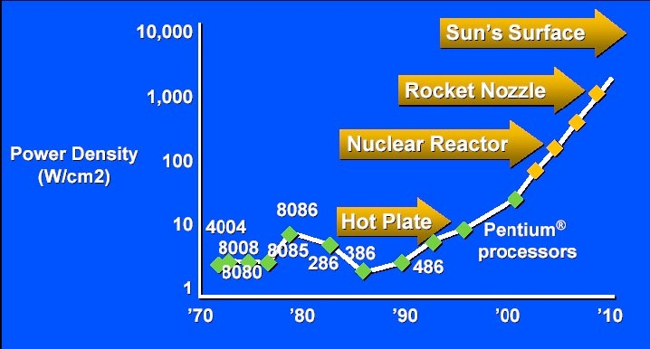
Intel hits the Power Density Wall
Inflection point in 2004
Pat Gelsinger, ISSCC 2001

Slide 16
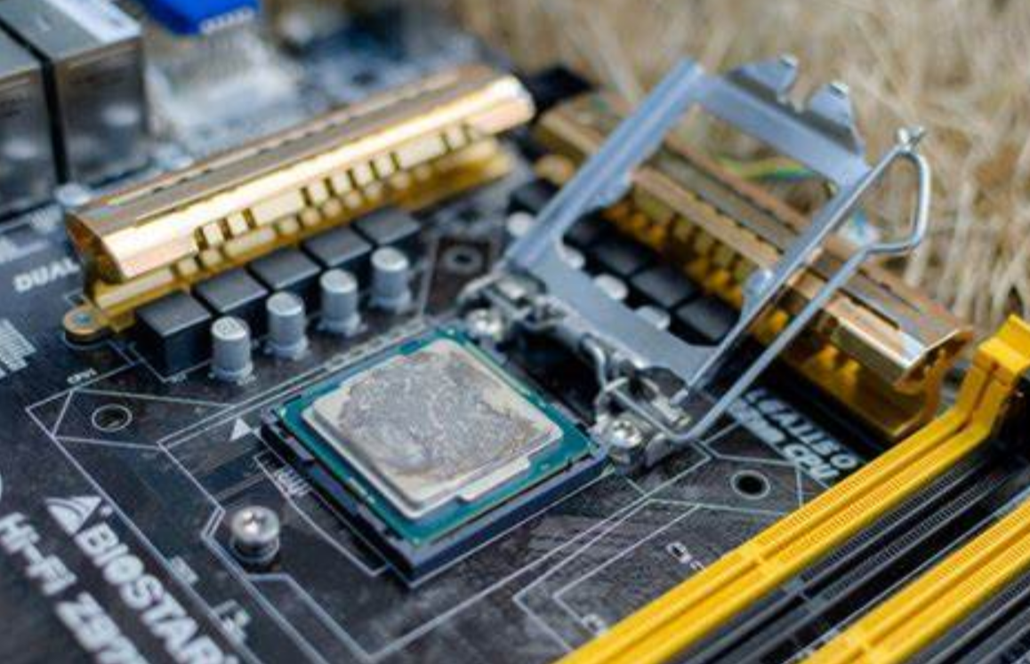
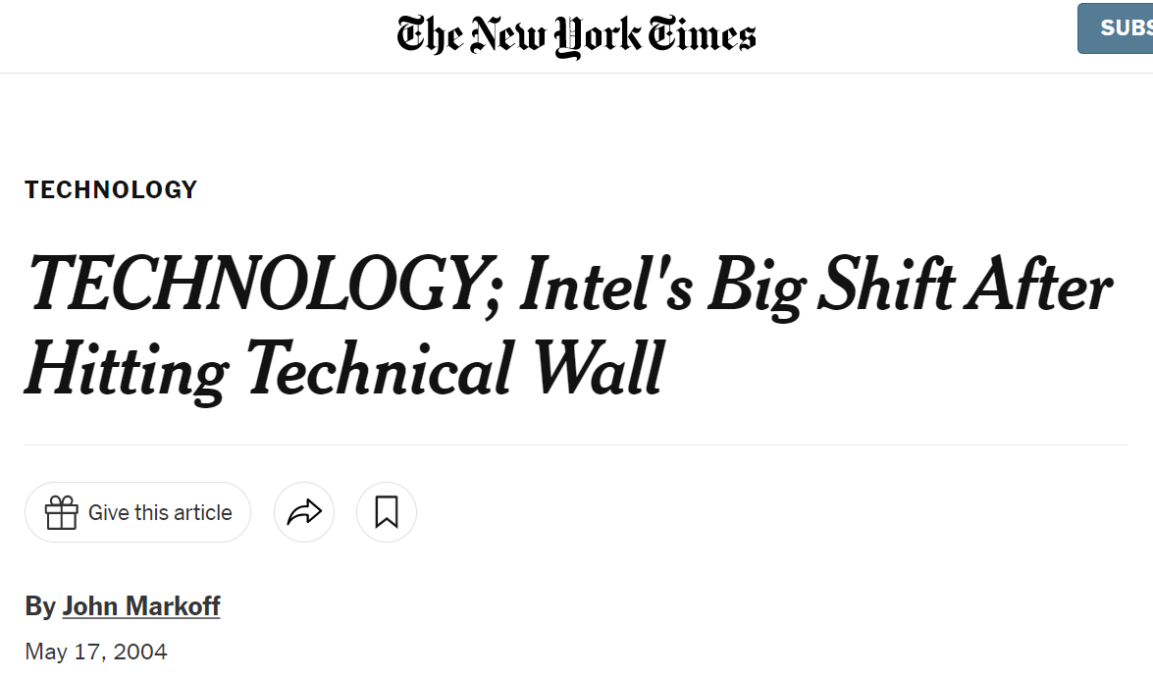
Intel's Big Shift After Hitting Technical Wall
Intel ‘s newest microprocessor was running slower and hotter than its predecessor.
Intel publicly acknowledged that it had hit a "thermal wall" on its microprocessor line.

Slide 17
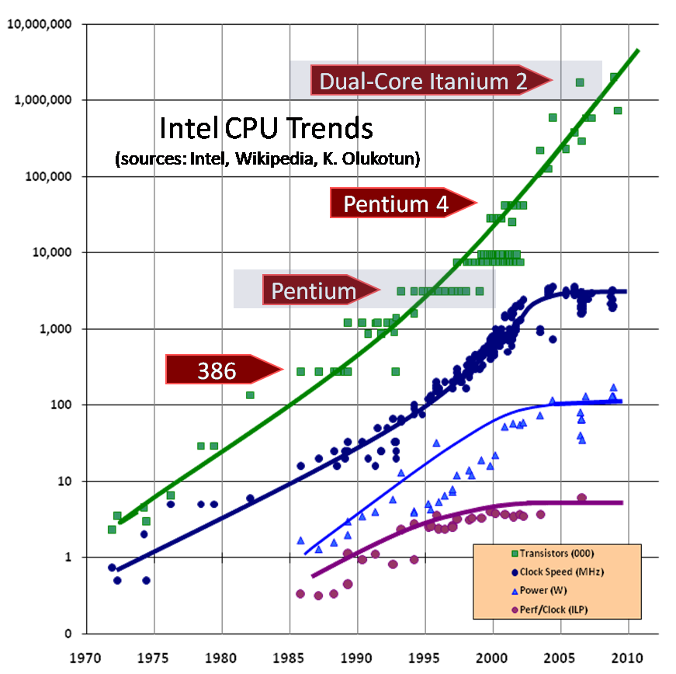



End of frequency scaling
Processor clock rate stops increasing
No further benefit from ILP
= Transistor density
= Clock frequency
= Power
= Instruction-level parallelism (ILP)
Image credit: “The free Lunch is Over” by Herb Sutter, Dr. Dobbs 2005

Slide 18
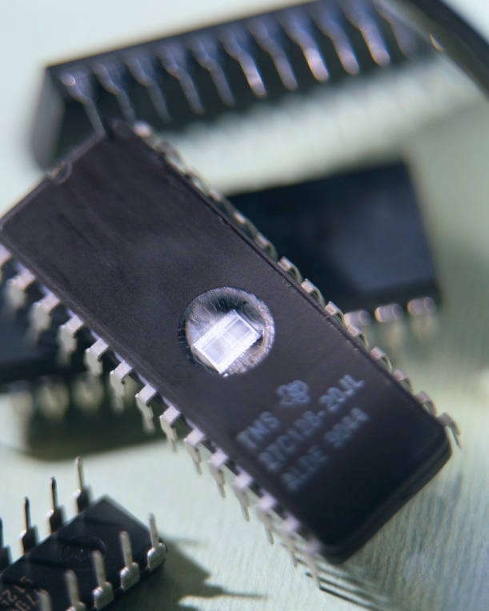
Solution
Move away from single-core systems to multicore processors.
“core” = central processing unit (CPU)
Introducing parallelism!!!

Slide 19
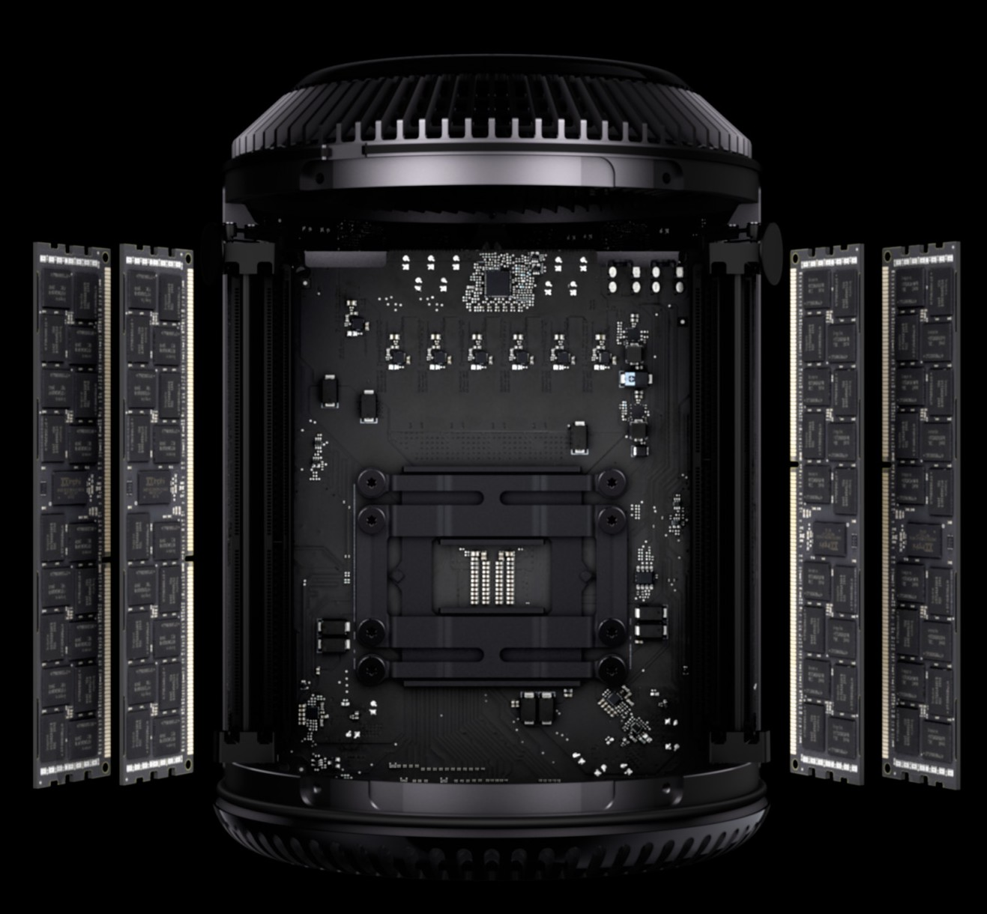



Parallel Machines Today
Examples from Apple’s product line:
Mac Pro
8 Intel Xeon E5 cores
iPhone XR
4 CPU cores
6 GPU cores
MacBook Pro Retina 15” 6 Intel Core i9 cores
iMac Pro
18 Intel Xeon W cores
(images from apple.com)

Slide 20
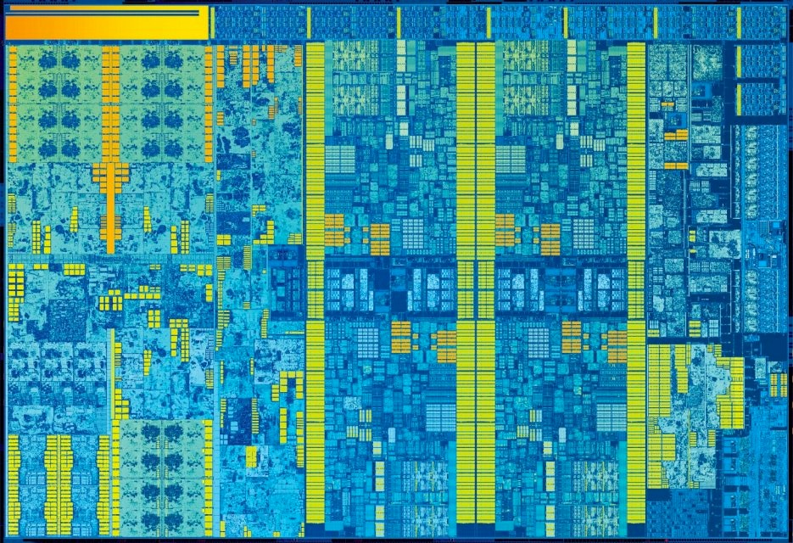




Intel Skylake (2015) (aka “6th generation Core i7”)
Quad-core CPU + multi-core GPU integrated on one chip
CPU
CPU
core
core
Integrated GPU
CPU
CPU
core
core

Slide 21
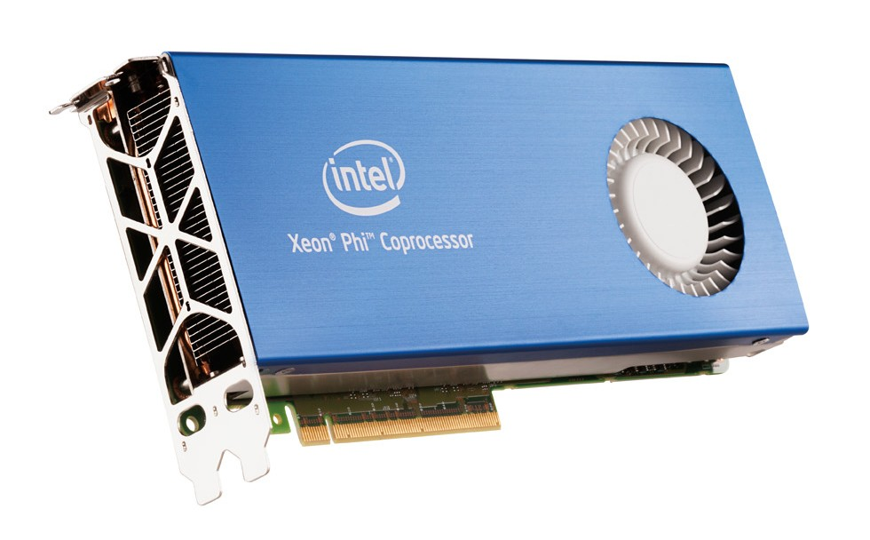
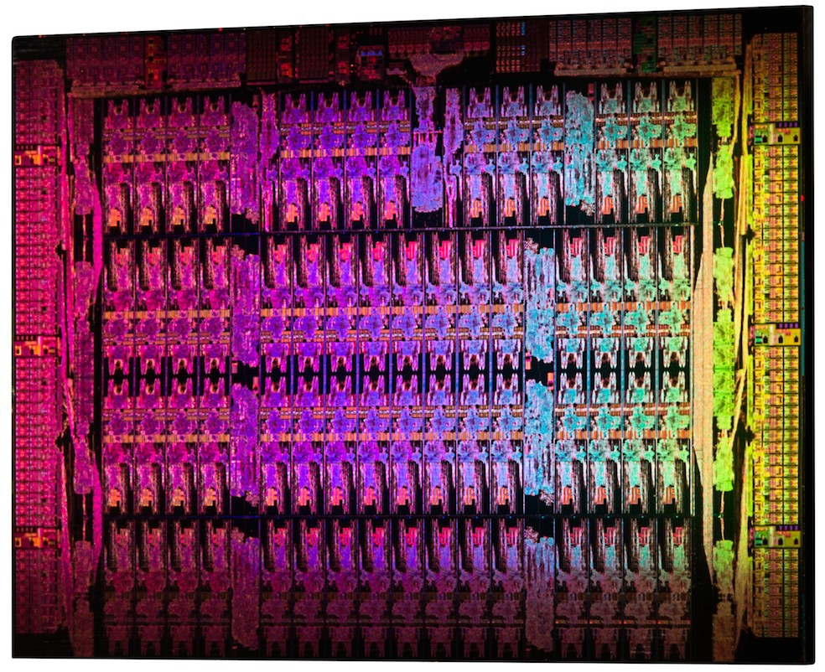
Intel Xeon Phi 7120A “coprocessor”
61 “simple” x86 cores (1.3 Ghz, derived from Pentium)
Targeted as an accelerator for supercomputing applications

Slide 22
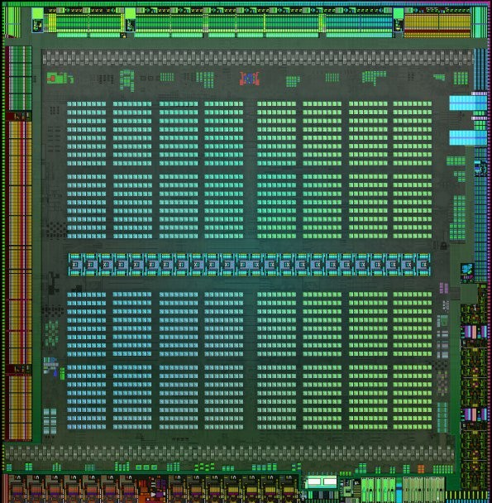
NVIDIA GV100 Volta GPU (2017)
80 major processing blocks
(but much, much more parallelism available... details coming soon)

Slide 23

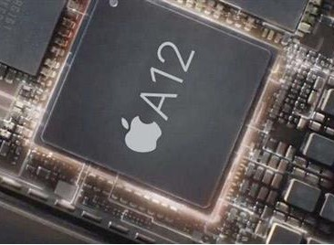
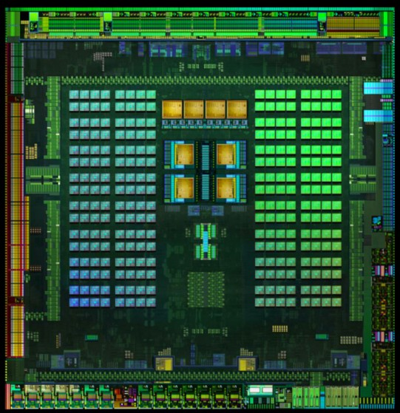
Mobile parallel processing
Power constraints heavily influence design of mobile systems
Apple A12: (in iPhone XR)
4 CPU cores
4 GPU cores Neural net engine
+ much more
NVIDIA Tegra K1: Quad-core ARM A57 CPU + 4 ARM A53 CPUs +
NVIDIA GPU + image processor...

Slide 24
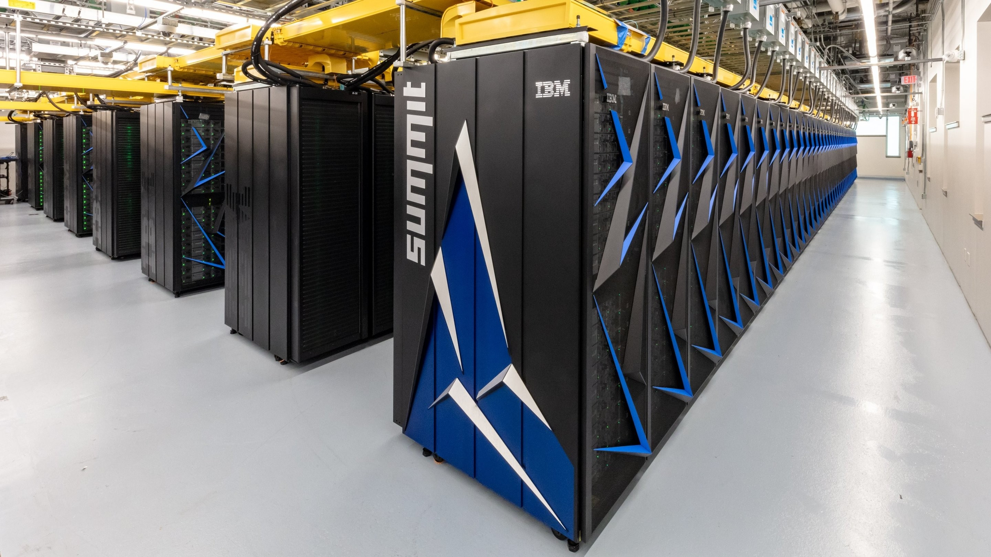
Supercomputing
Today: clusters of multi-core CPUs + GPUs
Oak Ridge National Lab: Summit
4,608 nodes
Each with two 22-core CPUs + 6 GPUs

Slide 25
Programmer’s Perspective on Performance
Question: How do you make your program run faster?
Answer before 2004:
- Just wait 6 months, and buy a new machine!
Answer after 2004:
- You need to write parallel software.

Slide 26
Now it’s up to the programmers
Adding more processors doesn’t help much if programmers aren’t aware of them…
… or don’t know how to use them.
Serial programs don’t benefit from this approach (in most cases).

Slide 27

Why we need to write parallel programs
Running multiple instances of a serial program often isn’t very useful.
Think of running multiple instances of your favorite game.
What you really want is for it to run faster.

Slide 28
Approaches to the serial problem
Rewrite serial programs so that they’re parallel.
Write translation programs that automatically convert serial programs into parallel programs.
This is very difficult to do.
Success has been limited.

Slide 29
More problems
Some coding constructs can be recognized by an automatic program generator, and converted to a parallel construct.
However, it’s likely that the result will be a very inefficient program.
Sometimes the best parallel solution is to step back and devise an entirely new algorithm.

Slide 30
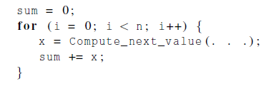
Example
Compute n values and add them together.
Serial solution:

Slide 31
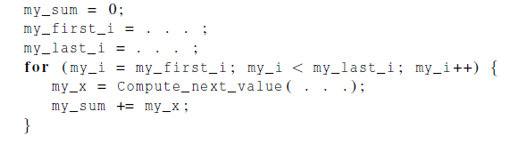
Example (cont.)
We have p cores, p much smaller than n.
Each core performs a partial sum of approximately n/p values.
Each core uses it’s own private variables and executes this block of code independently of the other cores.

Slide 32
Example (cont.)
After each core completes execution of the code, a private variable my_sum contains the sum of the values computed by its calls to Compute_next_value.
Ex., 8 cores, n = 24, then the calls to Compute_next_value return:
1,4,3, 9,2,8, 5,1,1, 5,2,7, 2,5,0, 4,1,8, 6,5,1, 2,3,9

Slide 33
Example (cont.)
Once all the cores are done computing their private my_sum, they form a global sum by sending results to a designated “master” core which adds the final result.

Slide 34
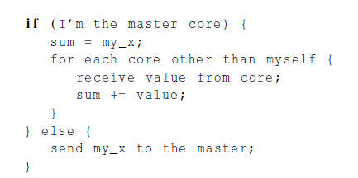
Example (cont.)

Slide 35
Example (cont.)
Core | 0 | 1 | 2 | 3 | 4 | 5 | 6 | 7
my_sum | 8 | 19 | 7 | 15 | 7 | 13 | 12 | 14
Global sum
8 + 19 + 7 + 15 + 7 + 13 + 12 + 14 = 95
Core | 0 | 1 | 2 | 3 | 4 | 5 | 6 | 7
my_sum | 95 | 19 | 7 | 15 | 7 | 13 | 12 | 14

Slide 36

But wait!
There’s a much better way to compute the global sum.

Slide 37
Better parallel algorithm
Don’t make the master core do all the work.
Share it among the other cores.
Pair the cores so that core 0 adds its result with core 1’s result.
Core 2 adds its result with core 3’s result, etc.
Work with odd and even numbered pairs of cores.

Slide 38
Better parallel algorithm (cont.)
Repeat the process now with only the evenly ranked cores.
Core 0 adds result from core 2.
Core 4 adds the result from core 6, etc.
Now cores divisible by 4 repeat the process, and so forth, until core 0 has the final result.

Slide 39
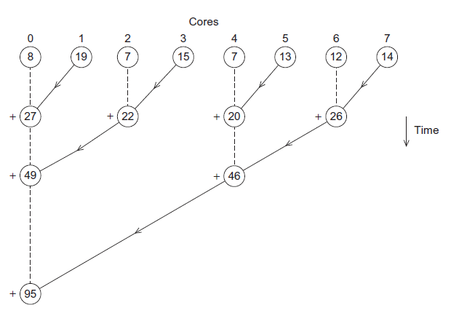
Multiple cores forming a global sum

Slide 40
Analysis
In the first example, the master core performs 7 receives and 7 additions.
In the second example, the master core performs 3 receives and 3 additions.
The improvement is more than a factor of 2!

Slide 41
Analysis (cont.)
The difference is more dramatic with a larger number of cores.
If we have 1000 cores:
The first example would require the master to perform 999 receives and 999 additions.
The second example would only require 10 receives and 10 additions.
That’s an improvement of almost a factor of 100!

Slide 42
How do we write parallel programs?
Task parallelism
Partition various tasks carried out solving the problem among the cores.
Data parallelism
Partition the data used in solving the problem among the cores.
Each core carries out similar operations on it’s part of the data.

Slide 43

Professor P
15 questions
300 exams

Slide 44

Professor P’s grading assistants
TA#1
TA#2
TA#3

Slide 45
Division of work – data parallelism
TA#1
TA#3
100 exams
100 exams
TA#2
100 exams

Slide 46
Division of work – task parallelism
TA#1
TA#3
Questions 11 - 15
Questions 1 - 5
TA#2
Questions 6 - 10

Slide 47
Division of work – data parallelism

Slide 48
Division of work – task parallelism
Tasks
Receiving
Addition

Slide 49
Coordination
Cores usually need to coordinate their work.
Communication – one or more cores send their current partial sums to another core.
Load balancing – share the work evenly among the cores so that one is not heavily loaded.
Synchronization – because each core works at its own pace, make sure cores do not get too far ahead of the rest.

Slide 50
What we’ll be doing
Learning to write programs that are explicitly parallel.
Using the C language.
Using three different extensions to C.
Message-Passing Interface (MPI)
Posix Threads (Pthreads)
OpenMP
And CUDA!

Slide 51
Type of parallel systems
Shared-memory
The cores can share access to the computer’s memory.
Coordinate the cores by having them examine and update shared memory locations.
Distributed-memory
Each core has its own, private memory.
The cores must communicate explicitly by sending messages across a network.

Slide 52
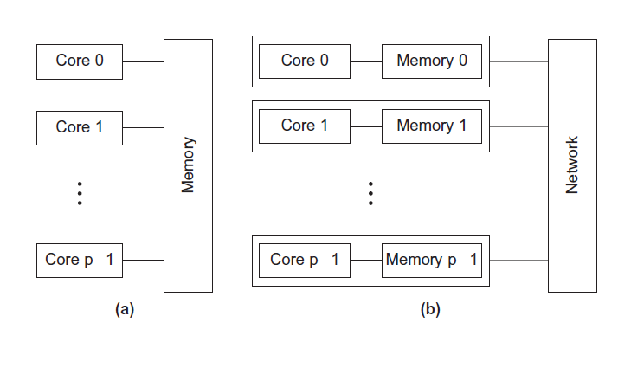
Type of parallel systems
Shared-memory
Distributed-memory

Slide 53
Terminology
Concurrent computing – a program is one in which multiple tasks can be in progress at any instant.
Parallel computing – a program is one in which multiple tasks cooperate closely to solve a problem
Distributed computing – a program may need to cooperate with other programs to solve a problem.

Slide 54
Concluding Remarks (1)
The laws of physics have brought us to the doorstep of multicore technology.
Serial programs typically don’t benefit from multiple cores.
Automatic parallel program generation from serial program code isn’t the most efficient approach to get high performance from multicore computers.

Slide 55
Concluding Remarks (2)
Learning to write parallel programs involves learning how to coordinate the cores.
Parallel programs are usually very complex and therefore, require sound program techniques and development.

Slide 56


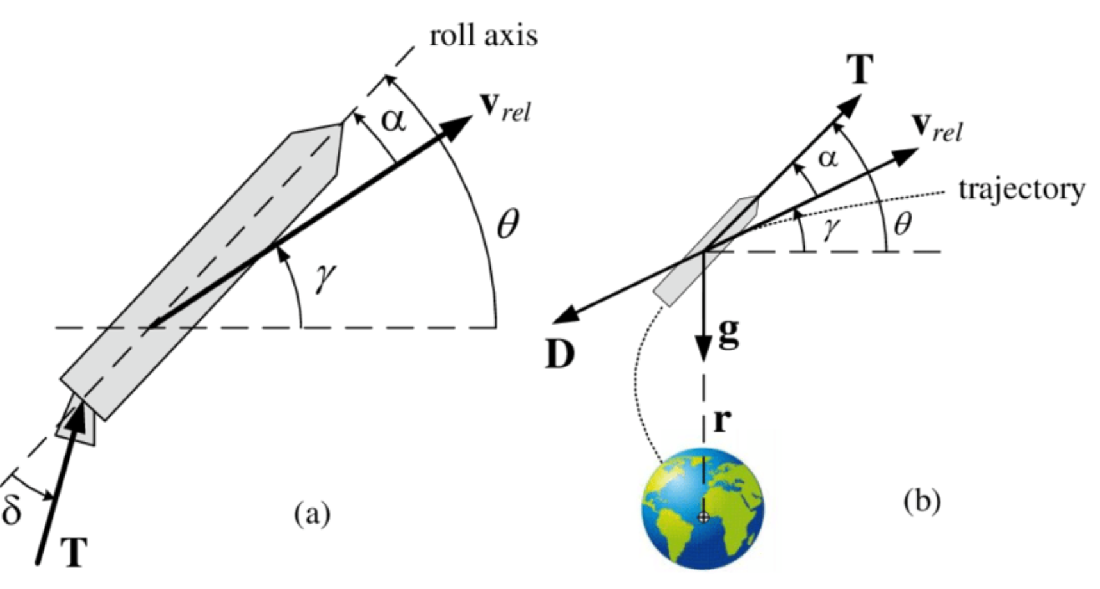
What you have learnt:
What you need to solve:

Slide 57
Supplementary materials

Slide 58
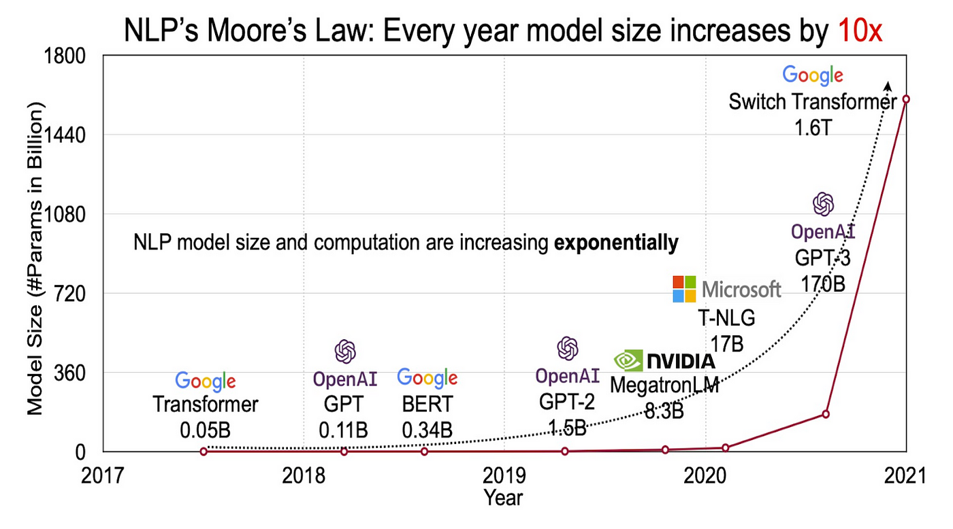
Increase of DNNs’ size
back
Notes:
Source: https://www.google.com/url?sa=i&url=https%3A%2F%2Fmedium.com%2F%40harishdatalab%2Funveiling-the-power-of-large-language-models-llms-e235c4eba8a9&psig=AOvVaw2CW0611G_B53hddnrUqQZX&ust=1708917865059000&source=images&cd=vfe&opi=89978449&ved=0CBMQjRxqFwoTCOiLvqTFxYQDFQAAAAAdAAAAABAJ

Slide 59
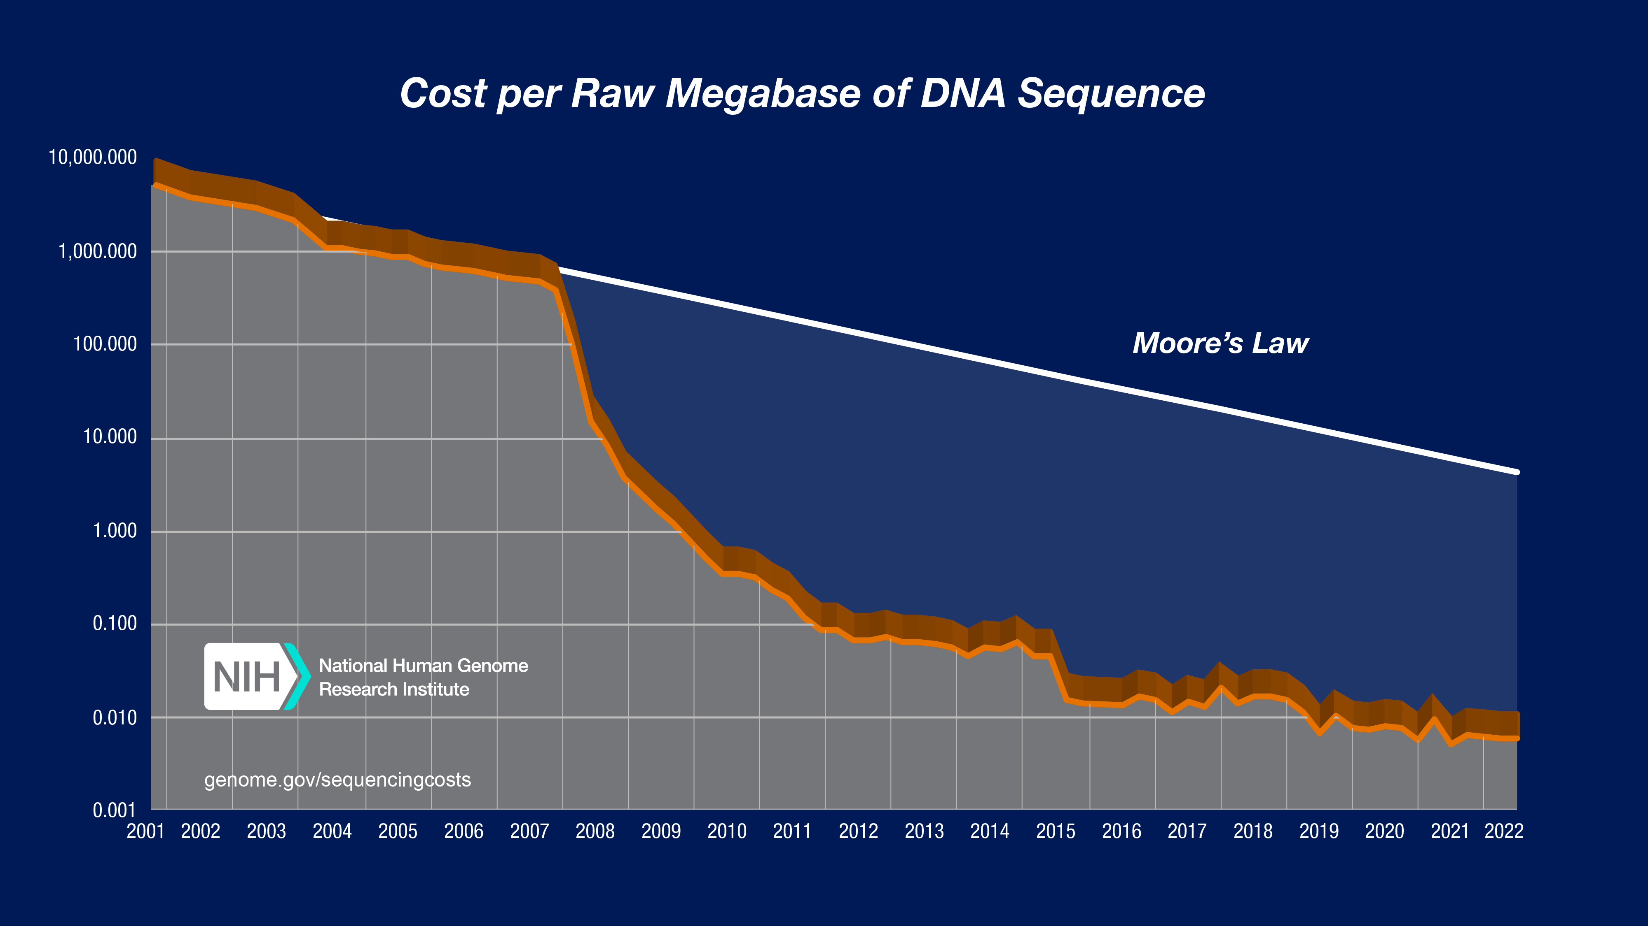
High-thoughput genotyping
back
Notes:
Source: https://www.google.com/url?sa=i&url=https%3A%2F%2Fwww.genome.gov%2Fabout-genomics%2Ffact-sheets%2FDNA-Sequencing-Costs-Data&psig=AOvVaw3BFOsDKm5jjFVyB1YyucKS&ust=1708919038555000&source=images&cd=vfe&opi=89978449&ved=0CBMQjRxqFwoTCLiqgtTJxYQDFQAAAAAdAAAAABAJ

Slide 60
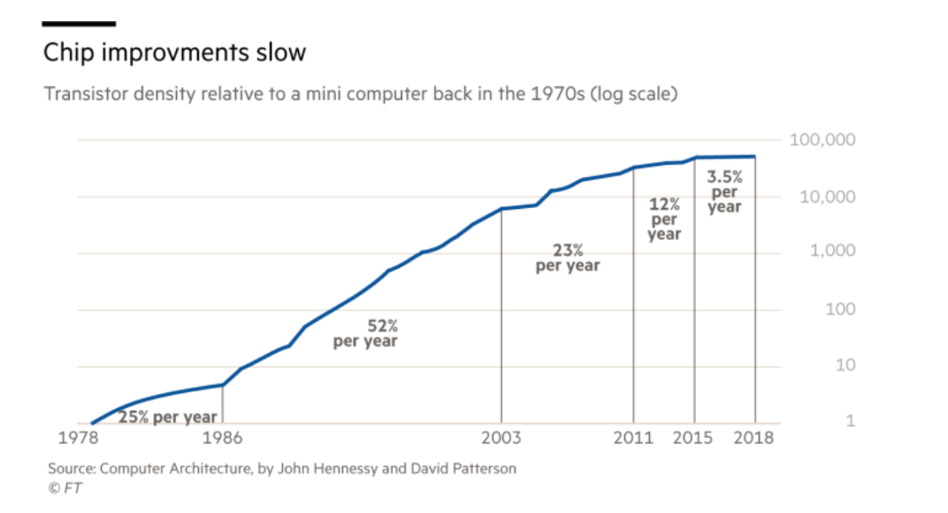
Transistor density improvements over the years
back
Notes:
Source: https://www.google.com/url?sa=i&url=https%3A%2F%2Fwww.reddit.com%2Fr%2Fhardware%2Fcomments%2F932jh2%2Ftransistor_density_improvements_over_the_years%2F&psig=AOvVaw0dBVcF9ODgZH_tDM76frtN&ust=1708952802473000&source=images&cd=vfe&opi=89978449&ved=0CBMQjRxqFwoTCJDe0bfHxoQDFQAAAAAdAAAAABAE

